Slide 1

Deep Fake Recognition {images}

Slide 2
DR: Islam Qabbani
ENG: Abdelrahman Mahmoud
Aya El Taher
Abdallah Mohamed
Shenouda safwat
Abdelwahab Salem
Mohamed Mahmoud

Slide 3

Deepfake detection (images): Deep Fake Detection using { Traditional Machine Learning and Dimensionality Reduction}

Slide 4
DFD
🔍 What is DeepFake?
DeepFake refers to synthetic media where a person in an existing image or video is replaced with someone else's likeness using AI techniques. It often results in highly realistic yet completely fake content.
⚠️ Why is DeepFake a Threat?
Misinformation: Spreads false narratives. Privacy Violation: Fake content can harm reputations. Security Risk: Can impersonate individuals in sensitive systems (e.g. facial recognition).
🎯 Project Goal
To build a DeepFake detection model using traditional Machine Learning methods only — without any Deep Learning — and to demonstrate the impact of dimensionality reduction techniques on detection performance.

Slide 5
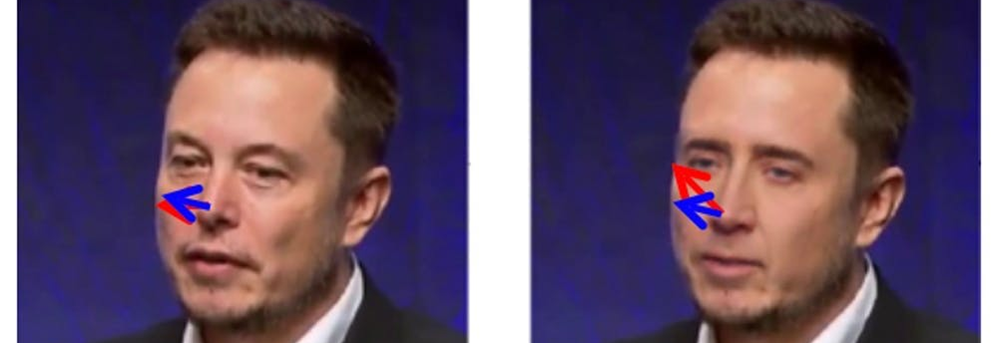
Deep Fake Detection Using Machine Learning And DR(Images)
EELU

Slide 6
Machine learning model steps
Data collection (dataset)
Preprocessing
Feature extraction
Feature selection
Train model
Evaluation
deployment

Slide 7
1- data collection
Link of dataset: https://www.kaggle.com/datasets/manjilkarki/deepfake-and-real-images
Name of data set: deepfake-and-real-images
Folders of dataset : train (real, fake)–test (real, fake)-validation (real, fake)
Number of files : train (70k, 70k) – test (5k, 5k) - validation (20k, 20k).
All files = 190K files in data set.

Slide 8


Example of images {Real & Fake}
REAL
FAKE

Slide 9
2- preprocessing
a. Introduction to Preprocessing:
Purpose: In this stage, we prepare the raw data (images) to be ready for use in the model.
The goal is to ensure that the images are correctly formatted in terms of size and type so that they are ready for feature extraction and model training.

Slide 10
2.Preprocessing {Data Loading}
Folder Setup: We loaded the data from the specific folders for Train, Test, and Validation datasets, each containing two categories:
Real images
Fake images
Label Assignment: We assigned "Real" images the label 0 and "Fake" images the label 1.
Image Loading: Each image is loaded using cv2.imread() and converted to grayscale to reduce data complexity.

Slide 11
2- preprocessing {Resizing}
Standardizing Image Size: To ensure all images are of the same dimensions, each image is resized to 96x96 pixels using cv2.resize().
Reason for choice: This size helps reduce computational load while ensuring the images are ready for feature extraction algorithms.

Slide 12
2- preprocessing
D.Storing Images and Labels:
Images and Labels: The images are stored in the images array, while the labels are stored in the labels array.
Images: Contain the data that will be used to train the model.
Labels: Contain values indicating whether the image is "Real" or "Fake".

Slide 13
2- preprocessing {Data Splitting}
Splitting the Data into Three Sets: The data is divided into three sets:
Training: For model training.
Testing: To evaluate the model’s performance after training.
Validation: To assess the model during training.
Organization: The data is loaded using the paths specified for each dataset group.

Slide 14
2- preprocessing { Displaying Results}
Data Shapes: The shapes of the data arrays for X_train, X_test, and X_val are printed along with their corresponding label arrays (y_train, y_test, y_val).
Result: This shows the size of data available in each group.
Train images: (140002, 96, 96) Labels: (140002,)
Test images: (10905, 96, 96) Labels: (10905,)
Validation images: (39428, 96, 96) Labels: (39428,)
Explanation: This is an important step to understand the available data volume and its balance across different categories.

Slide 15
Importance of Preprocessing:
Improving Data Quality: This stage ensures that the data fed into the model is of better quality, enhancing the model’s accuracy and efficiency.
Reducing Complexity: By resizing the images and converting them to grayscale, we reduce computational complexity in subsequent stages like feature extraction and model training.
Ensuring Consistency: Preprocessing ensures that the model works with consistent and compatible data.

Slide 16
3-Feature extraction
Objective: The goal of feature extraction is to convert raw images into a for machine leaformat that is more suitable rning models.
Techniques Used:
Histogram of Oriented Gradients (HOG)
Local Binary Pattern (LBP)
Color Histograms(CH)
Discrete Cosine Transform (DCT)

Slide 17
3-Feature extraction
: HOG Feature Extraction
Title: 1. HOG (Histogram of Oriented Gradients) Features Content:
Purpose: HOG is used to capture the edge information and gradient direction in an image.
Method:
The image is divided into cells, and histograms of gradient directions are computed.
The histograms are then combined to describe the shape and structure of the object.
Implementation:
Parameters used:
Orientations = 9
Pixels per cell = (8, 8)
Cells per block = (2, 2)
Block normalization = 'L2-Hys'
Result: Provides a detailed description of edge patterns that can help in distinguishing between real and fake images.

Slide 18
3-Feature extraction
: LBP Feature Extraction
Title: 2. LBP (Local Binary Pattern) Histogram Features Content:
Purpose: LBP is used to capture texture information by comparing pixel values with their neighbors.
Method:
The image is processed to generate a binary pattern from pixel neighbors.
The result is then represented as a histogram of these binary patterns.
Implementation:
Parameters used:
P = 16 (number of neighboring pixels)
R = 2 (radius of the neighborhood)
Method = 'uniform' (for uniform LBP patterns)
Normalization:
The histogram is normalized so that the sum of values equals 1.
Result: LBP captures texture patterns, which are essential for detecting subtle differences between real and fake images.

Slide 19
3-Feature extraction
Color Histogram Feature Extraction
Title: 3. Color Histogram Features Content:
Purpose: Color histograms capture the color distribution of an image, which is crucial for recognizing differences in real vs. fake images.
Method:
The image is converted to the HSV color space (Hue, Saturation, Value).
Histograms are calculated for each of the three channels (H, S, V) separately.
Implementation:
Histograms are calculated with 8 bins for each channel.
The histograms are then normalized to ensure they sum to 1.
Result: Helps in identifying color distribution changes that could indicate tampering in the image.

Slide 20
3-Feature extraction
.DCT (Discrete Cosine Transform) Features Content:
Purpose: DCT is used to capture frequency components of the image, focusing on the most significant frequencies for image representation.
Method:
DCT is applied twice (first along the rows, then along the columns).
The first 500 coefficients are retained to avoid excessive data size while preserving key frequency information.
Implementation:
The DCT coefficients are flattened into a 1D array.
Result: Captures the frequency features of the image, which are important for identifying pixel-level anomalies.

Slide 21
3-Feature extraction
Combining All Features:
The features extracted from HOG, LBP, Color Histograms, and DCT are concatenated into a single feature vector for each image.
Implementation:
combined = np.hstack([hog_features, lbp_hist, color_hist, dct_features])
Result:
The final feature vector contains information from all four methods, allowing the model to learn from diverse aspects of the image.

Slide 22
Result After Feature Extraction:
Train features shape: (140002, 4890)
Test features shape: (10905, 4890)
Validation features shape: (39428, 4890)

Slide 23
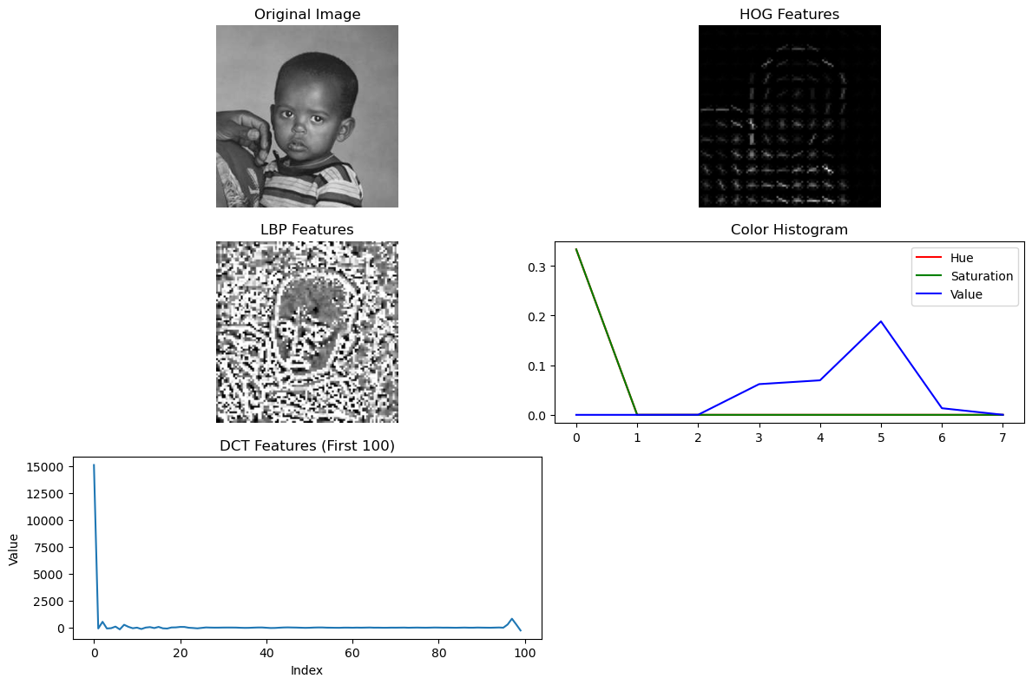

Slide 24
Importance of Feature Extraction (FX)
Raw images contain high-dimensional data that is not directly usable by most machine learning models.
Feature Extraction transforms images into meaningful numerical representations, capturing:
Texture (e.g., LBP)
Shape (e.g., HOG)
Color Information (e.g., HSV histograms)
Frequency Patterns (e.g., DCT)
It plays a critical role in the success of classical ML approaches by providing a compact and informative summary of image content.
The quality of features directly impacts the classifier’s performance.

Slide 25
4- Feature selection
Feature Selection using SelectKBest
Reducing Dimensionality to Improve Model Performance
Why Feature Selection?
Our extracted feature vector had 4,890 features.
Too many features can lead to:
Overfitting
Longer training time
Decreased generalization
Goal: Keep only the most relevant features for classification.

Slide 26
4- Feature selection
Method Used - SelectKBest
Method: SelectKBest with ANOVA F-test
SelectKBest: Selects the top k features based on a scoring function.
Scoring Function: f_classif (ANOVA F-value) — measures the linear dependency between features and labels.
Chosen Value of k: 2000 best features.
Why ANOVA F-test?
It's suitable for classification tasks.
Fast and interpretable.

Slide 27
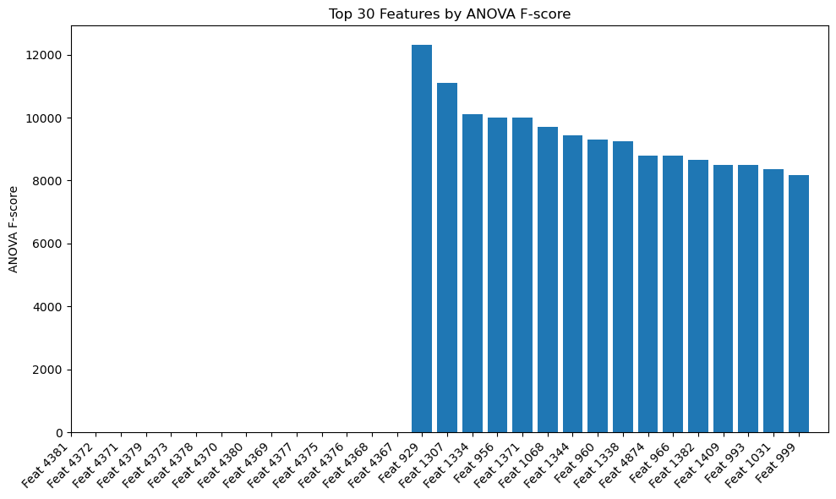
Top 30 Features by ANOVA F-score

Slide 28
Importance of Feature Selection
Why is Feature Selection Important?
Even after feature extraction, we may end up with thousands of features, many of which are:
Redundant
Irrelevant
Noisy
Feature Selection helps to:
Reduce dimensionality → Faster training & less overfitting.
Improve model accuracy by focusing only on the most informative features.
Simplify the model and reduce complexity.
Acts as a filter that highlights what truly matters for classification.
Visual idea: Feature vector → FS block (SelectKBest) → Shorter feature vector with highlighted important parts

Slide 29
5-Model Training:
الخوارزمية | النوع (Type) | خطية؟ (Linear?) | المزايا (Pros) | العيوب (Cons) | مناسب لـ (Best Use Case)
SVM | تصنيف (Classification) | ✅ خطية أو ❌ غير خطية (حسب الـ kernel) | - دقيق جدًا مع البيانات المعقدة- جيد للـ High Dimensional Data | - بطيء مع البيانات الضخمة- حساس لاختيار الـ kernel والمعاملات | تصنيف الصور والنصوص، مشاكل فيها حدود فاصلة معقدة
Random Forest | تصنيف وتنبؤ (Classification & Regression) | ❌ غير خطية | - قوي ضد الـ overfitting- لا يحتاج تجهيز كبير للبيانات | - بطيء- قد يصعب تفسيره أحيانًا | البيانات الكبيرة أو غير المعالجة، مشاكل التصنيف المعقدة
XGBoost | تصنيف وتنبؤ | ❌ غير خطية | - أداء قوي جدًا- يتعامل مع Missing Data- أفضلية في المسابقات | - يحتاج tuning- أكثر تعقيدًا من Random Forest | حالات تحتاج دقة عالية وتحسين دقيق
KNN | تصنيف | ❌ غير خطية | - بسيط وسهل الفهم- لا يحتاج تدريب فعلي | - بطيء عند التنبؤ- حساس للتوسيع والضوضاء | حالات تعليمية، بيانات صغيرة الحجم
Logistic Regression | تصنيف ثنائي (Binary Classification) | ✅ خطية | - سهل وسريع- واضح في التفسير | - لا يناسب البيانات غير الخطية أو المعقدة | مشاكل بسيطة مثل spam detection أو تصنيفات ثنائية
Naive Bayes | تصنيف | ✅ خطية (تقريبًا) | - سريع جدًا- فعال مع بيانات النصوص (مثل الكلمات) | - يفترض استقلالية الخصائص (وده مش دايمًا واقعي) | تحليل النصوص، تصنيف البريد العشوائي، baseline بسيط

Slide 30
5-Model Training:
المعيار | XGBoost 🏆 | Random Forest | SVM | Logistic Regression
السرعة والكفاءة | سريع جدًا بفضل parallelism و tree pruning | جيد لكنه أبطأ مع بيانات كبيرة | بطيء في التدريب خاصة مع بيانات كثيرة | سريع لكنه أبسط
الأداء على بيانات غير خطية | ممتاز (يدعم non-linear و interactions) | ممتاز برضو | ممتاز لكن حساس للـ parameters | ضعيف
معالجة البيانات غير المتوازنة | يدعم scale_pos_weight و eval_metric | يحتاج تعديل يدوي مثل class_weight | يدعم class_weight | يدعم
التحكم في Overfitting | قوي جدًا بفضل eta, gamma, early_stopping | جيد | حساس لـ C والـ kernel | ضعيف
تفسير المخرجات | يدعم Feature Importance و SHAP بسهولة | يدعم Feature Importance | صعب التفسير غالبًا | سهل
النتائج التجريبية عندك | ✅ أفضل F1 على validation و test | متوسط | أقل من XGBoost | أضعفهم

Slide 31
After SelectKBest :
Algorithm | F1-Score (Validation) | F1-Score (Test)
Logistic Regression | .. | ..
SVM (rbf) | -- | --
Random Forest | 0.81 | 0.72
XGBoost | 0.81 | 0.79

Slide 32
5-Model Training: XGBoost
XGBoost Results – Superior Performance on Test Data.
• Gradient Boosting-based, highly accurate
• Handles non-linear data effectively
• Built-in regularization reduces overfitting
• Supports early stopping to optimize training time
• Ranks feature importance automatically

Slide 33
5-Model Training: XGBoost
Before we use this algorithm we will search the best Hyperparameter :
Hyperparameter Tuning (XGBoost Optimization)"
Slide Bullet Points:
Used RandomizedSearchCV to explore best settings for XGBoost.
Tuned parameters: max_depth, learning_rate, n_estimators, etc.
Performed -3fold cross-validation on each configuration.
Automatically selected the best combination to boost accuracy.

Slide 34
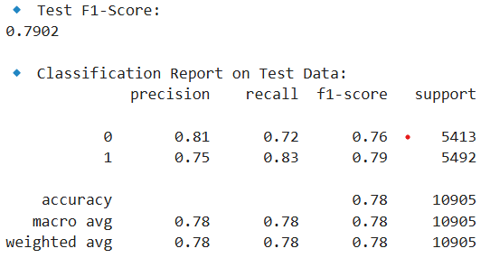
5-Model Training: XGBoost
Before SelectKBest this is our accuracy:

Slide 35
Feature Selection with SelectKBest (ANOVA)
Applied SelectKBest with ANOVA F-test to reduce feature space.
Purpose: Keep only the most relevant features that have high correlation with class labels.
Tried multiple values for k (number of features): 2000, 2500, 3000.
Trained Random Forest model on each feature set and evaluated F1-score.
Best k found = ✅ 2000, achieved F1-Score = ✅ 0.7902 on validation set.
Dimensionality reduction improved model speed and sometimes performance.
{PCA- Recursive Feature Elimination -chi2}

Slide 36
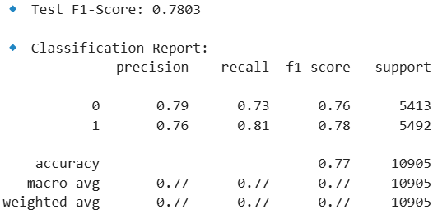
The accuracy after ANOVA:

Slide 37
6- evaluation

Slide 38
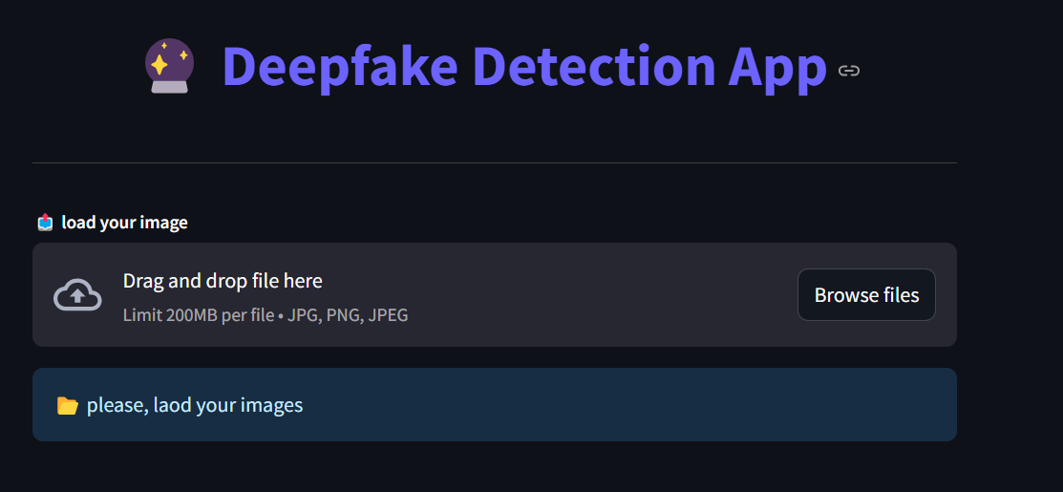
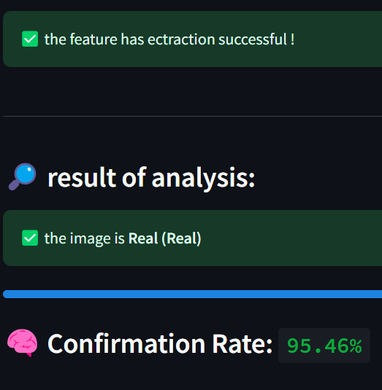
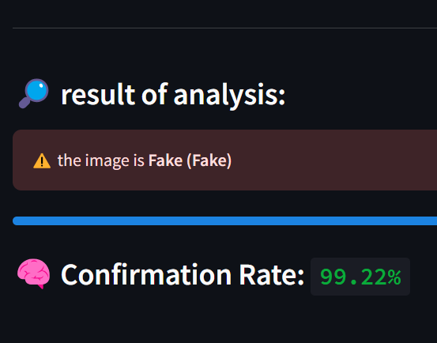
8- Deployment
We use GUI by Streamlit :

Slide 39
Summary:
Preprocessing: (prepare images)
Feature extraction using: HOG LBP CH DCT
Feature selection: ANOVA
Random search for hyperparameter tuning
Training using XGBoost
Evaluation f1= 79% accuracy = 78%

Slide 40

thanks

